Slide 1

VISUALIZATION REPORTING & COMMUNICATION
World Life Expectancy
& Happiness
Hien Do & Khanh Dang
M.S.B.A
Prof. Shakeel Khan
Notes:
https://pixabay.com/en/achievement-agreement-business-3481967/

Slide 2
01
World Life Expectancy
Notes:
https://pixabay.com/en/business-professional-teamwork-1219868/

Slide 3
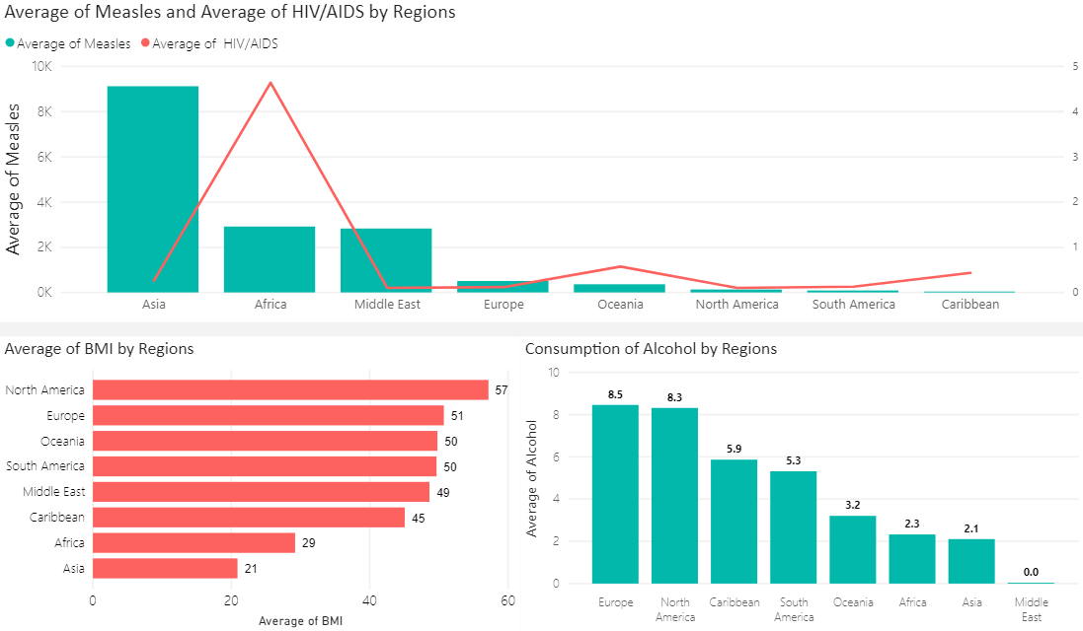
Health Factors: Africa is the region with the highest rate of HIV/AIDS, Asia has significant number of measles cases compare to other regions, North America is the region with the highest BMI as 57
Lifestyle: The consumption of alcohol in Europe and America are much higher than other countries

Slide 4
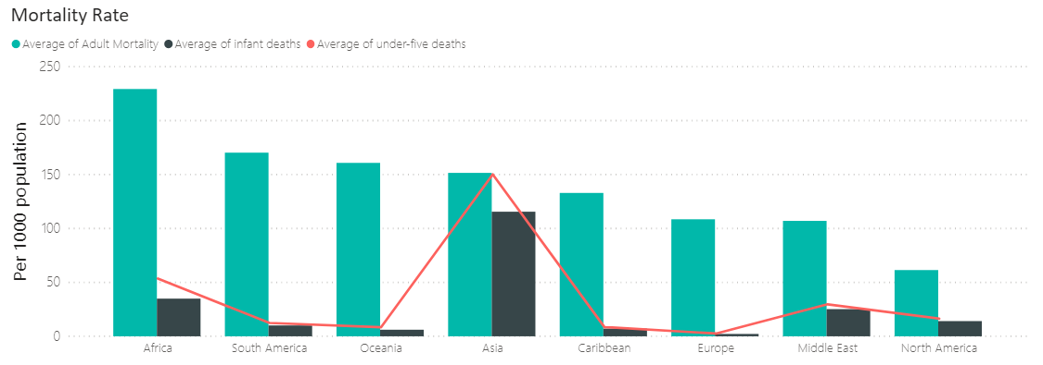
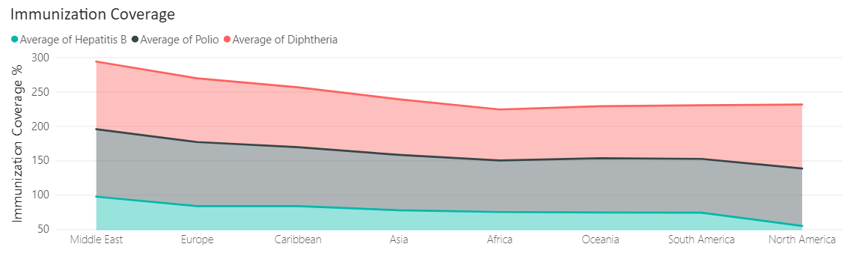
Mortality: Africa has the highest rate of adult mortality which can be explained by poor heath care system and environment. While Asia countries have remarkable rate of infant and under-five death because Diphtheria and Polio are more common for children in Asia area.
Immunization: The immunization coverage of those disease among 1 year old children is low in America

Slide 5
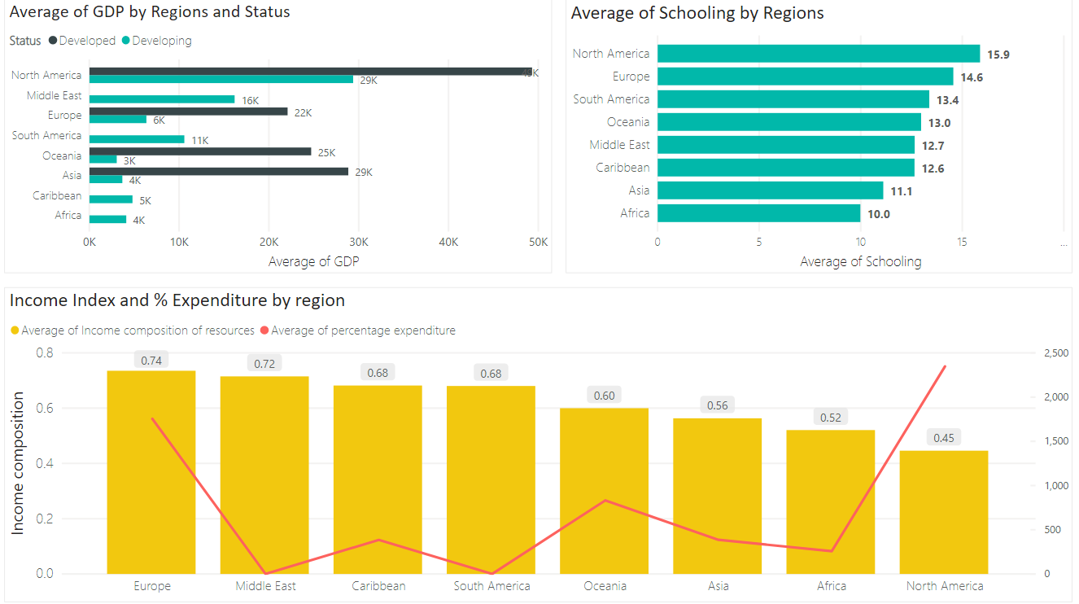
All developed countries are much higher than developing countries in GDP
Africa region has no developed countries

Slide 6
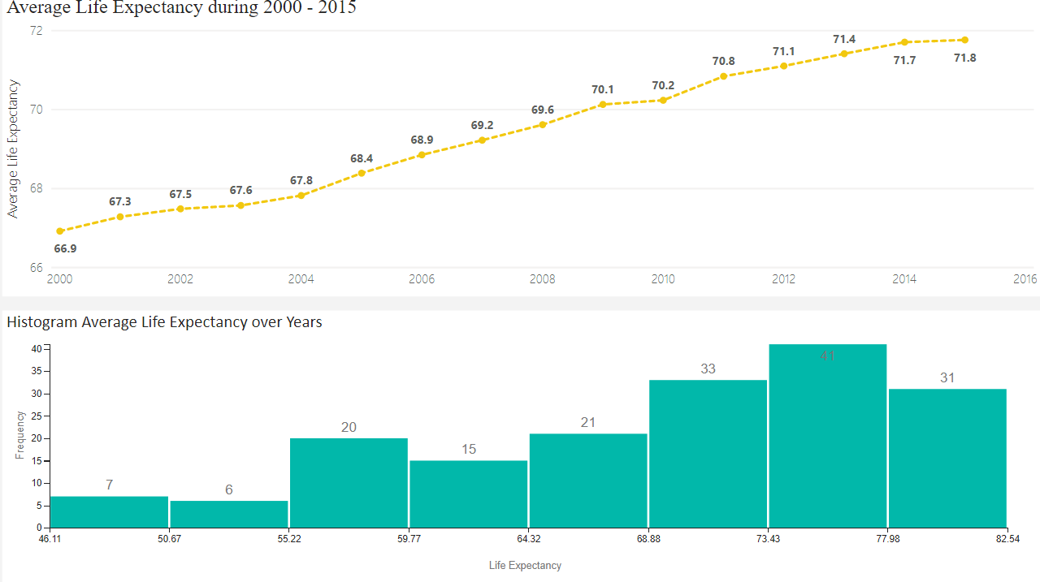

Slide 7
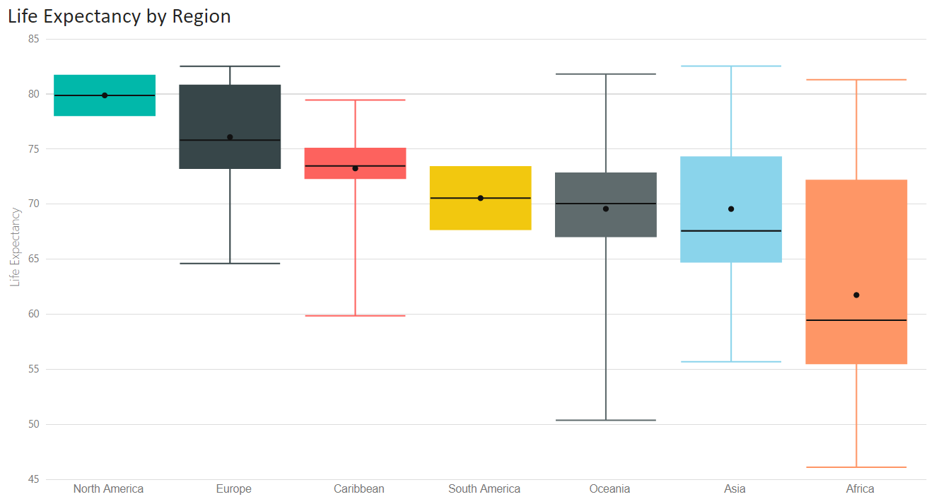
Life expectancy by region: North America and Europe are the regions experiencing high life expectancy. However, the range of life expectancy in Europe is much higher. It can be explained that North America has good rate of all mentioned factors while there are some developing countries in Europe

Slide 8
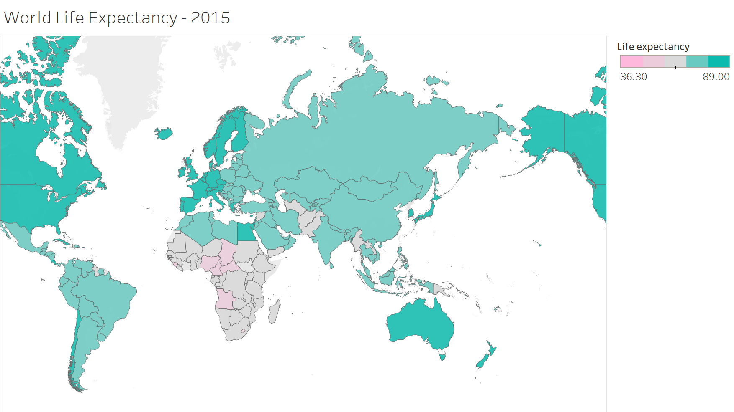

Slide 9
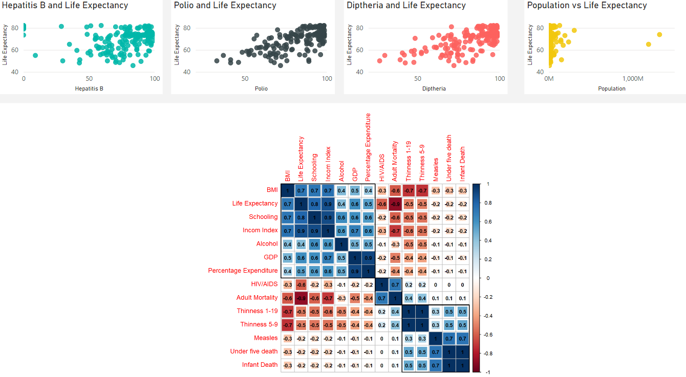
Relation between life expectancy and factors

Slide 10
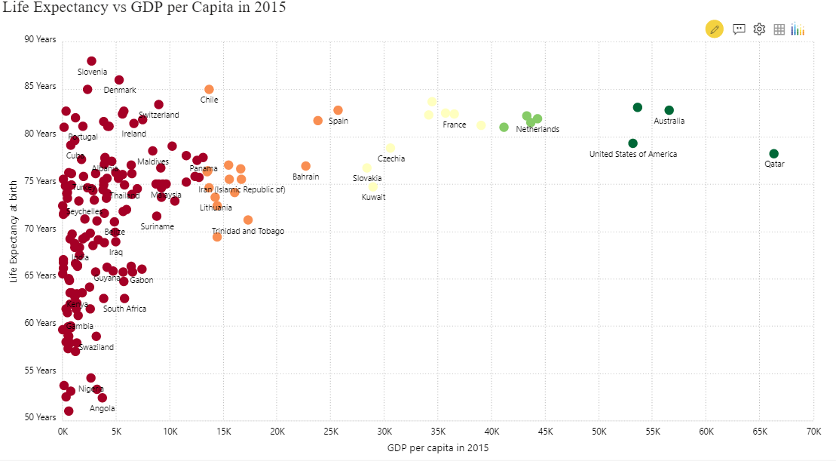
Some countries with high GDP may face challenges such as medical problems, air pollution which result in lower life expectancy

Slide 11
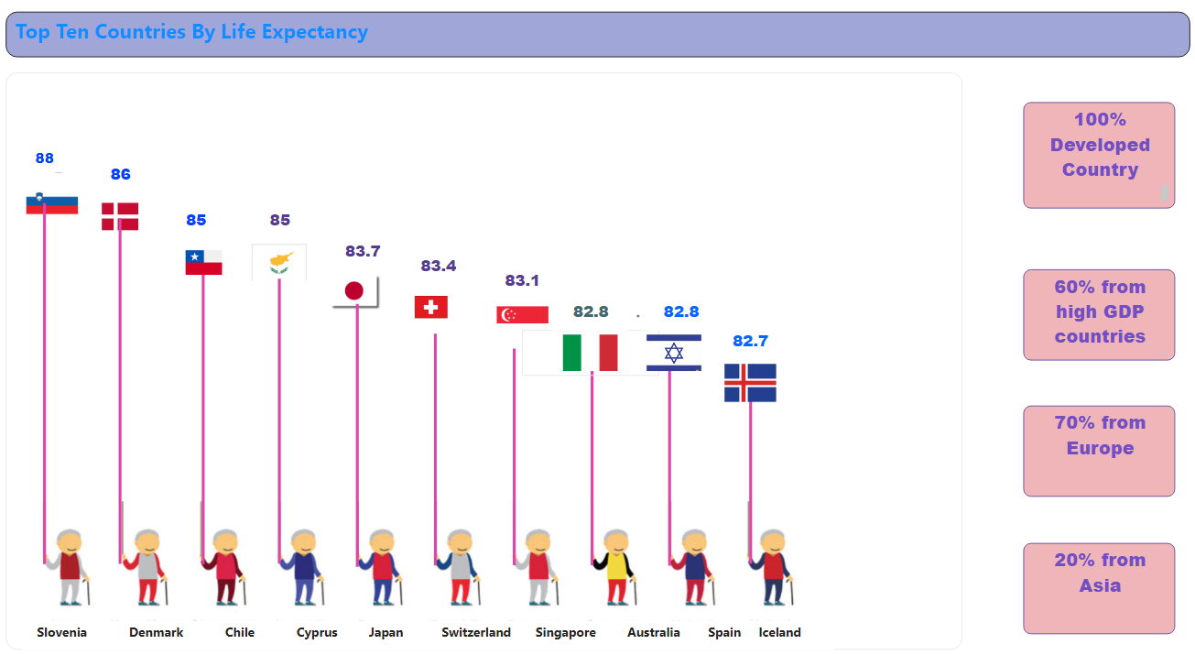

Slide 12
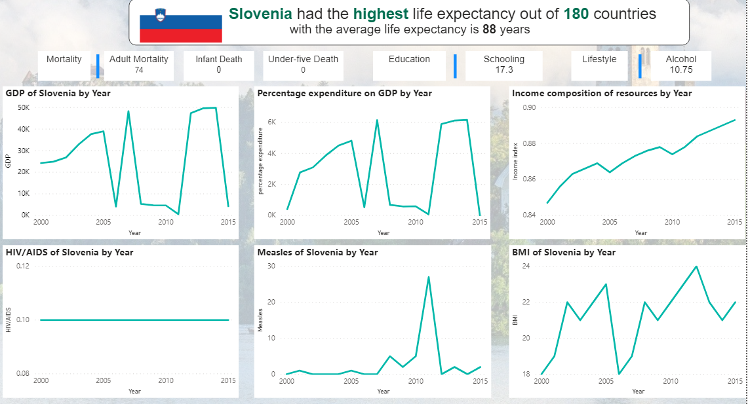

Slide 13
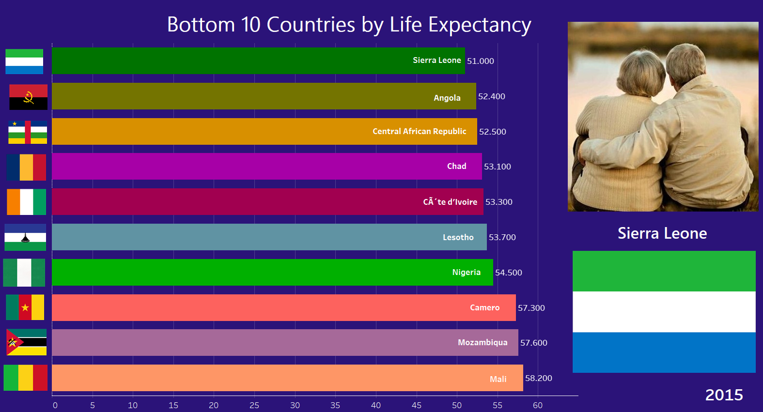

Slide 14
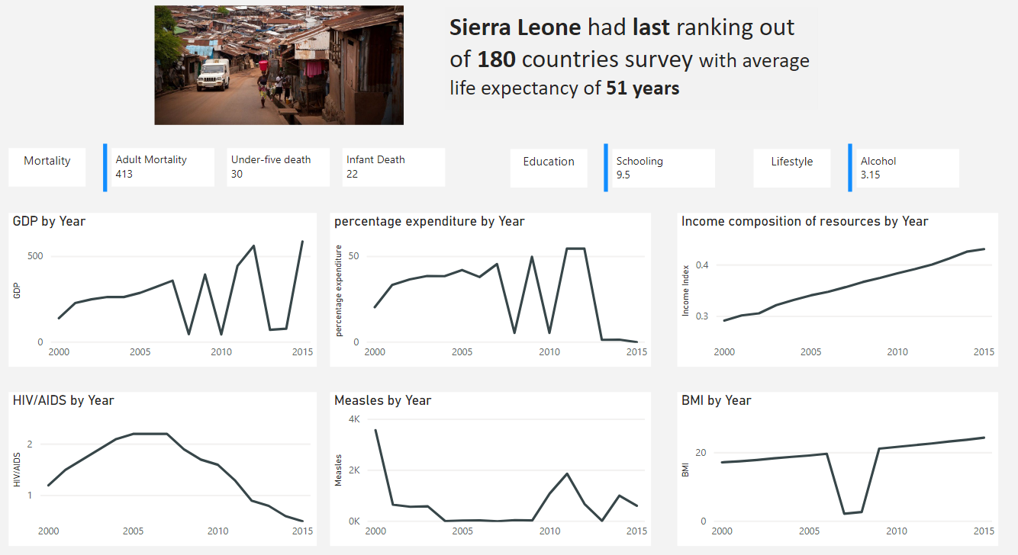

Slide 15
02
WORLD HAPPINESS
Notes:
https://pixabay.com/en/meetings-coffee-shop-people-cafe-1149198/

Slide 16
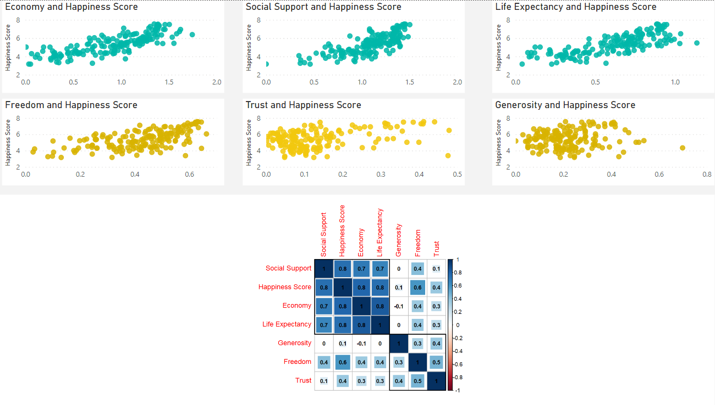
Relation between Happiness and factors

Slide 17
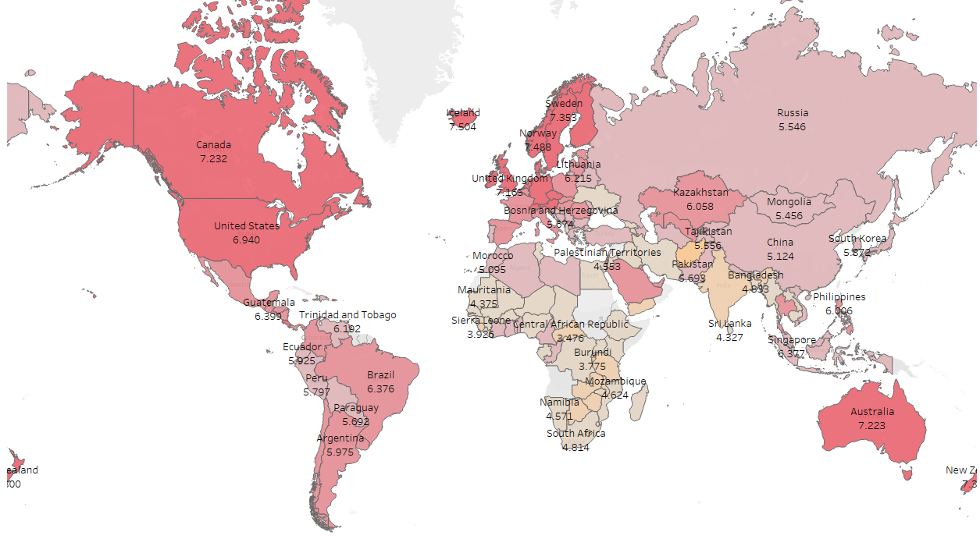










Most Happy
Finland
Second Ranking
Denmark
Third Ranking
Switzerland
Least Happy
Afghanistan
Third Ranking
Rwanda
Second Ranking
Zimbabwe
Low Score
High Score

Slide 18
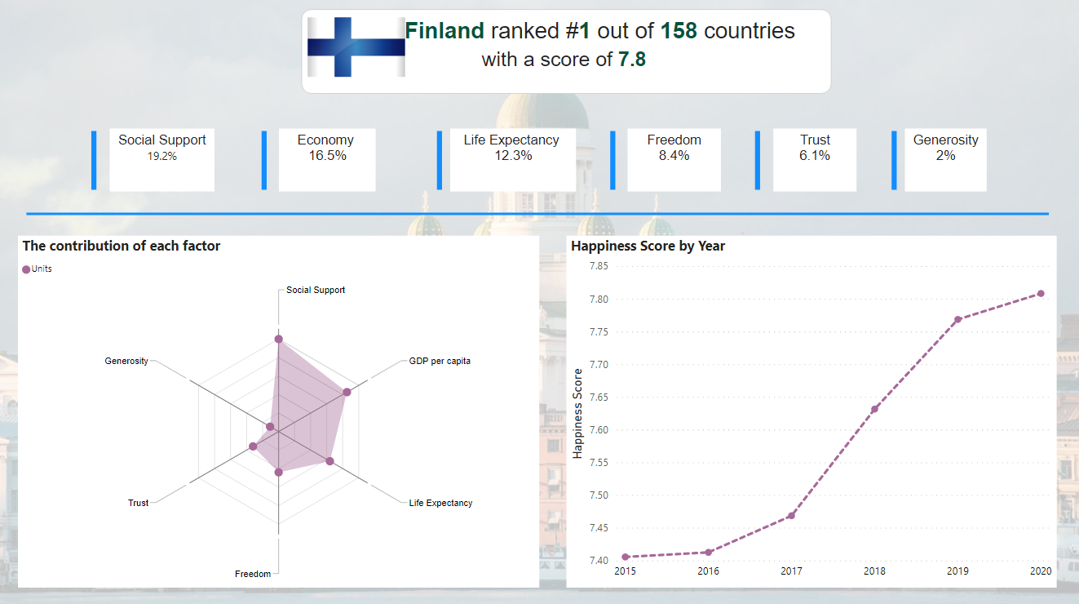

Slide 19
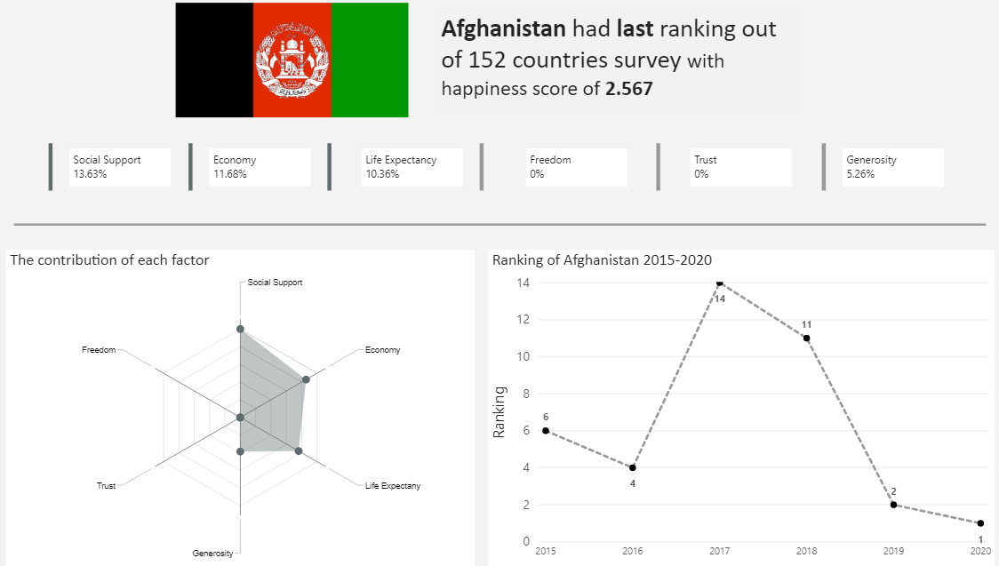

Slide 20
Advantage
Obstacles
Long-term solution for health problems
Higher efficient in working productivity
Reducing crime rate
Reducing employee turn over rate
Fewer working – age people
Shortage of qualified workers
Economy can’t fill in-demand occupations
Causing inflation
Immigration issues
Spending more for health care and social support

Slide 21
THANK YOU

